Slide 1

CS for Social Good

Slide 2
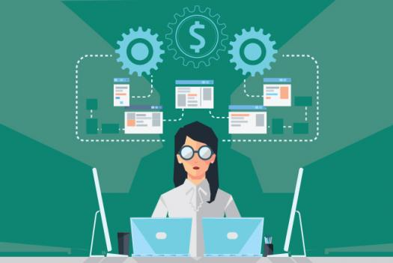
You’ve coming to a close with your CS class. Congrats, you’re now a developer!

Slide 3



Now the question is what can you do with these skills?

Slide 4
What more can you do? And what can you do right now?

Slide 5
THE BIG QUESTION:
How can we use technology and CS to improve people’s lives?
Notes:
Stop here to actually have students raise their hands to answer this question.
If people are thinking of relatively trivial impacts (to more privileged problems), reframe the question as one of how technology can create social impact.
Goal: have students start thinking originally about how this can happen.

Slide 6
People are being to recognize and harness the power of tech for good now more than ever.

Slide 7

Saving lives in a disaster
Stanford student Lekan Wang helped the CDC combine open source information with epidemiological data from the field to gain improved situational awareness about the cholera outbreak in Haiti.
Notes:
Stanford student Lekan Wang who was interning at Palantir at the time helped the CDC predict a cholera outbreak in Haiti saving hundreds of thousands of lives.
http://web.stanford.edu/group/sjph/cgi-bin/sjphsite/palantir-healt/

Slide 8
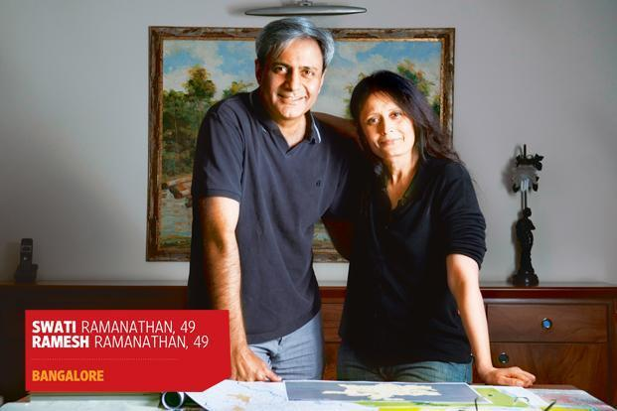
Reducing corruption
Ramesh and Swati Ramanathan created ipaidabribe.com, an online portal to report bribe-taking officers and force bureaucratic reform in several government departments.
Notes:
Here’s my favorite story. Tired of corruption in their country, Ramesh and Swati Ramanathan created a Google form allowing anybody anywhere to report a corrupt or a bribe taking officer. They sent these names to their media friends leading to hundreds of sting operations and over 6000 corrupt officers losing their jobs.
Now: has uncovered $459 million in bribes. Feel free to have students check out the website! http://ipaidabribe.com
KEY TAKEAWAY: ***Such a simple application of technology can have such a monumental impact -- the tech doesn’t have to be complex, and can use extrapolations of what you know now in order to make impact!***

Slide 9
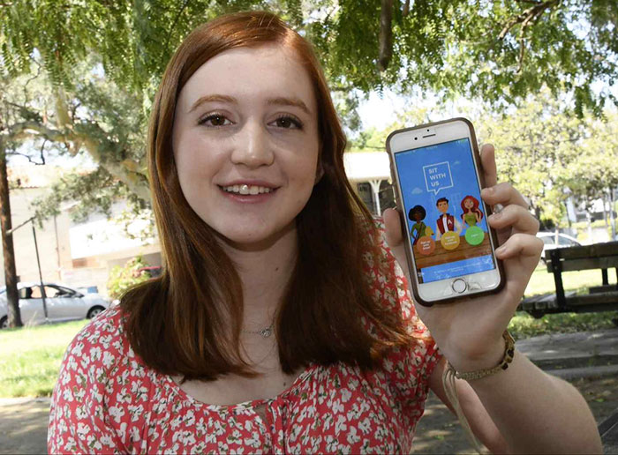
Sit With Us
Notes:
Simple but powerful way to counteract bullying -- find ways to pair students who don’t have anyone to sit with at lunch with those who are welcoming to give them a place to sit!
Takeaway: Students at age 16 can do this. Simple, but powerful idea, using no more technical concepts than you would need from APCS.
http://losangeles.cbslocal.com/2016/09/14/high-school-student-develops-sit-with-us-app-to-encourage-inclusion-at-lunchtime/
http://mag.amazing-kids.org/amazing-kids-of-the-month1/amazing-kid-of-the-month-natalie-hampton-may-2017/

Slide 10
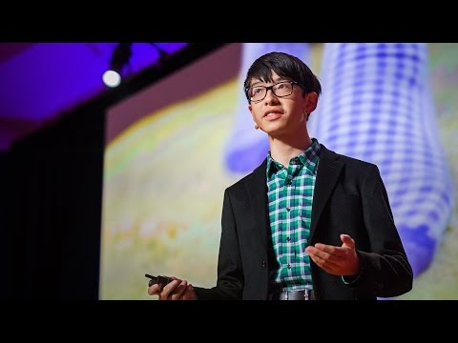
App for Alzheimer's patients
Notes:
Optional slide. May be useful to share this video with students to watch at home, since it’s long.

Slide 11
We Are: CS+Social Good
And we will be helping to show you how you can make a difference with CS

Slide 12
We Are: CS+Social Good
Mission:
Empower students to use tech for social good
Change the culture of tech to focus on social impact
What we do:
Started at Stanford; now expanded to Brown, Georgia Tech, Cornell, and 10 other schools
Run programs engaging college and high school students in using technology for impact!
Notes:
Read more about us here:
http://125.stanford.edu/cssocial-good/ → feel free to show the video
https://medium.com/cs-social-good/what-we-do-cs-social-good-d1a693f1a46a
http://cs4good.com

Slide 13
So, what will we be doing?

Slide 14

Understanding how technology can impact and improve the world

Slide 15
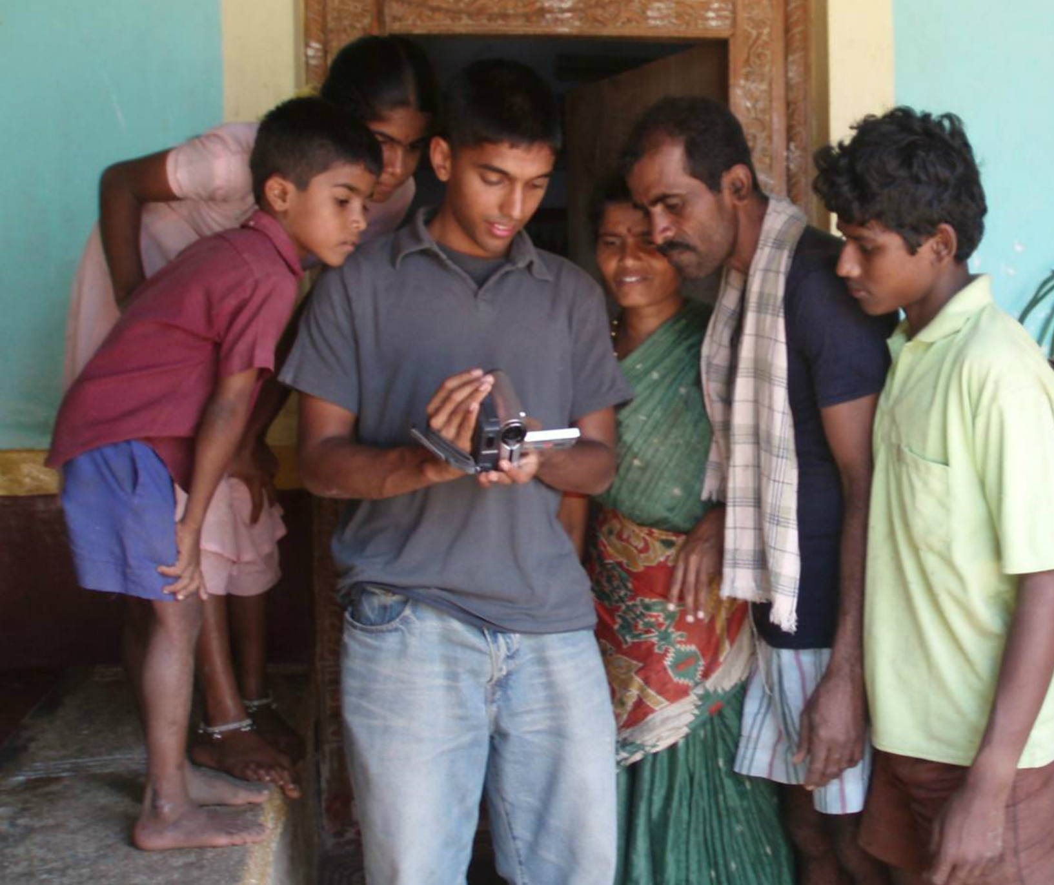
Implement projects that create social value

Slide 16
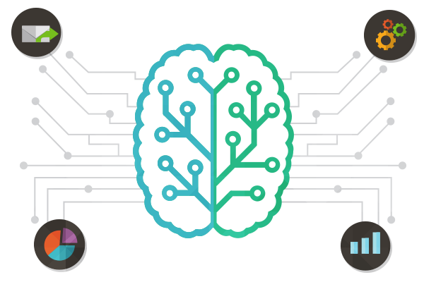
Use machine learning algorithms to make predictions

Slide 17
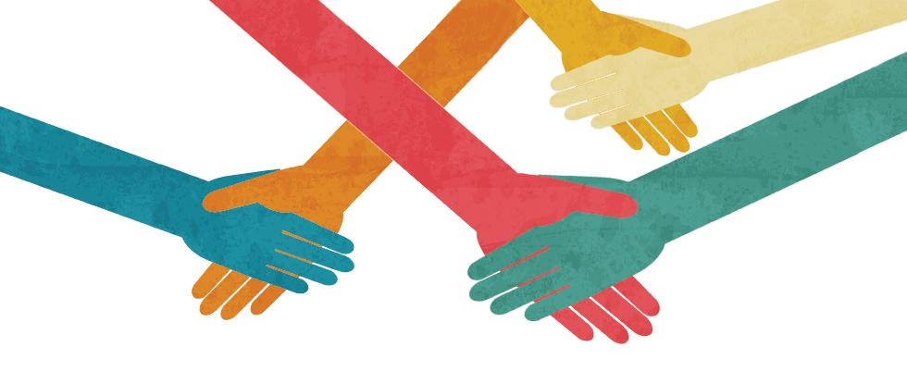
Design your own project to help a local or global community

Slide 18
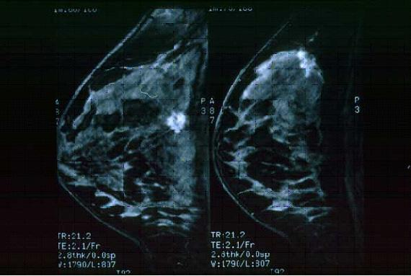

We're going to be working on a series of projects together...
Machine learning to classify breast cancer data
Mental Health Support Resources
Notes:
NOTE: If you’re a teacher doing different projects (or neither of these) → let us know or make a copy and edit the one-two projects you’re doing

Slide 19
And a Series of Workshops!
We’ll learn about some social problems in the world
You’ll design your own solution to a problem you care about
And we’ll explore concepts like virtual reality

Slide 20
Get ready to learn, have fun, and understand the power of Computer Science!!
Sahaj Garg
Chris Barnes
Marilyn Zhang
Gunguk Kim
Elena Mosse
Sara Frigui

